Slide 1
Catan®: The Harbor Analysis
Machine Learning and Data Science

Slide 2
Introduction
Shawzub Raza, Wayne State University 5th year
Biomedical Physics, Mathematics, and Psychology B.S
I used Python to code this data which I am familiar with
I also used SQL and Skilearn (ML) for the first time

Slide 3
What is Catan®
A 1-4 player-based board game
Players take roles of settlers who build settlements and holdings to get resources or trade with players or harbors
For players to win they need to obtain 10 victory points via cards and buildings
Getting resources and trading are essential to obtaining victory points

Slide 4
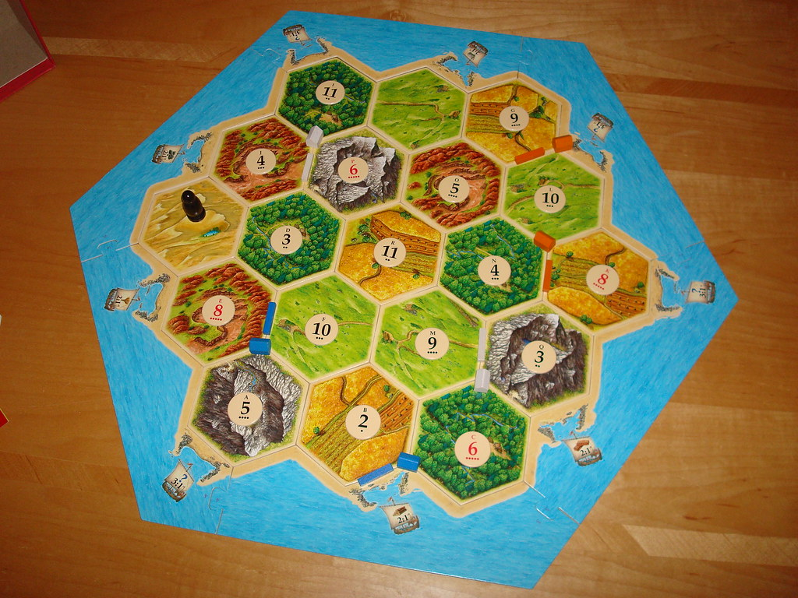
How do you play Catan®

Slide 5
Problem Statement
How many harbors lead to a winning strategy ?

Slide 6
Product/Hack
I used a combination of SQL and Python to generate and analysis the data to my problem statement
SQL Cleaned and generated the CSV files to use for data analysis
Python was used to run data analysis using ski-learn to obtain a K- mean

Slide 7
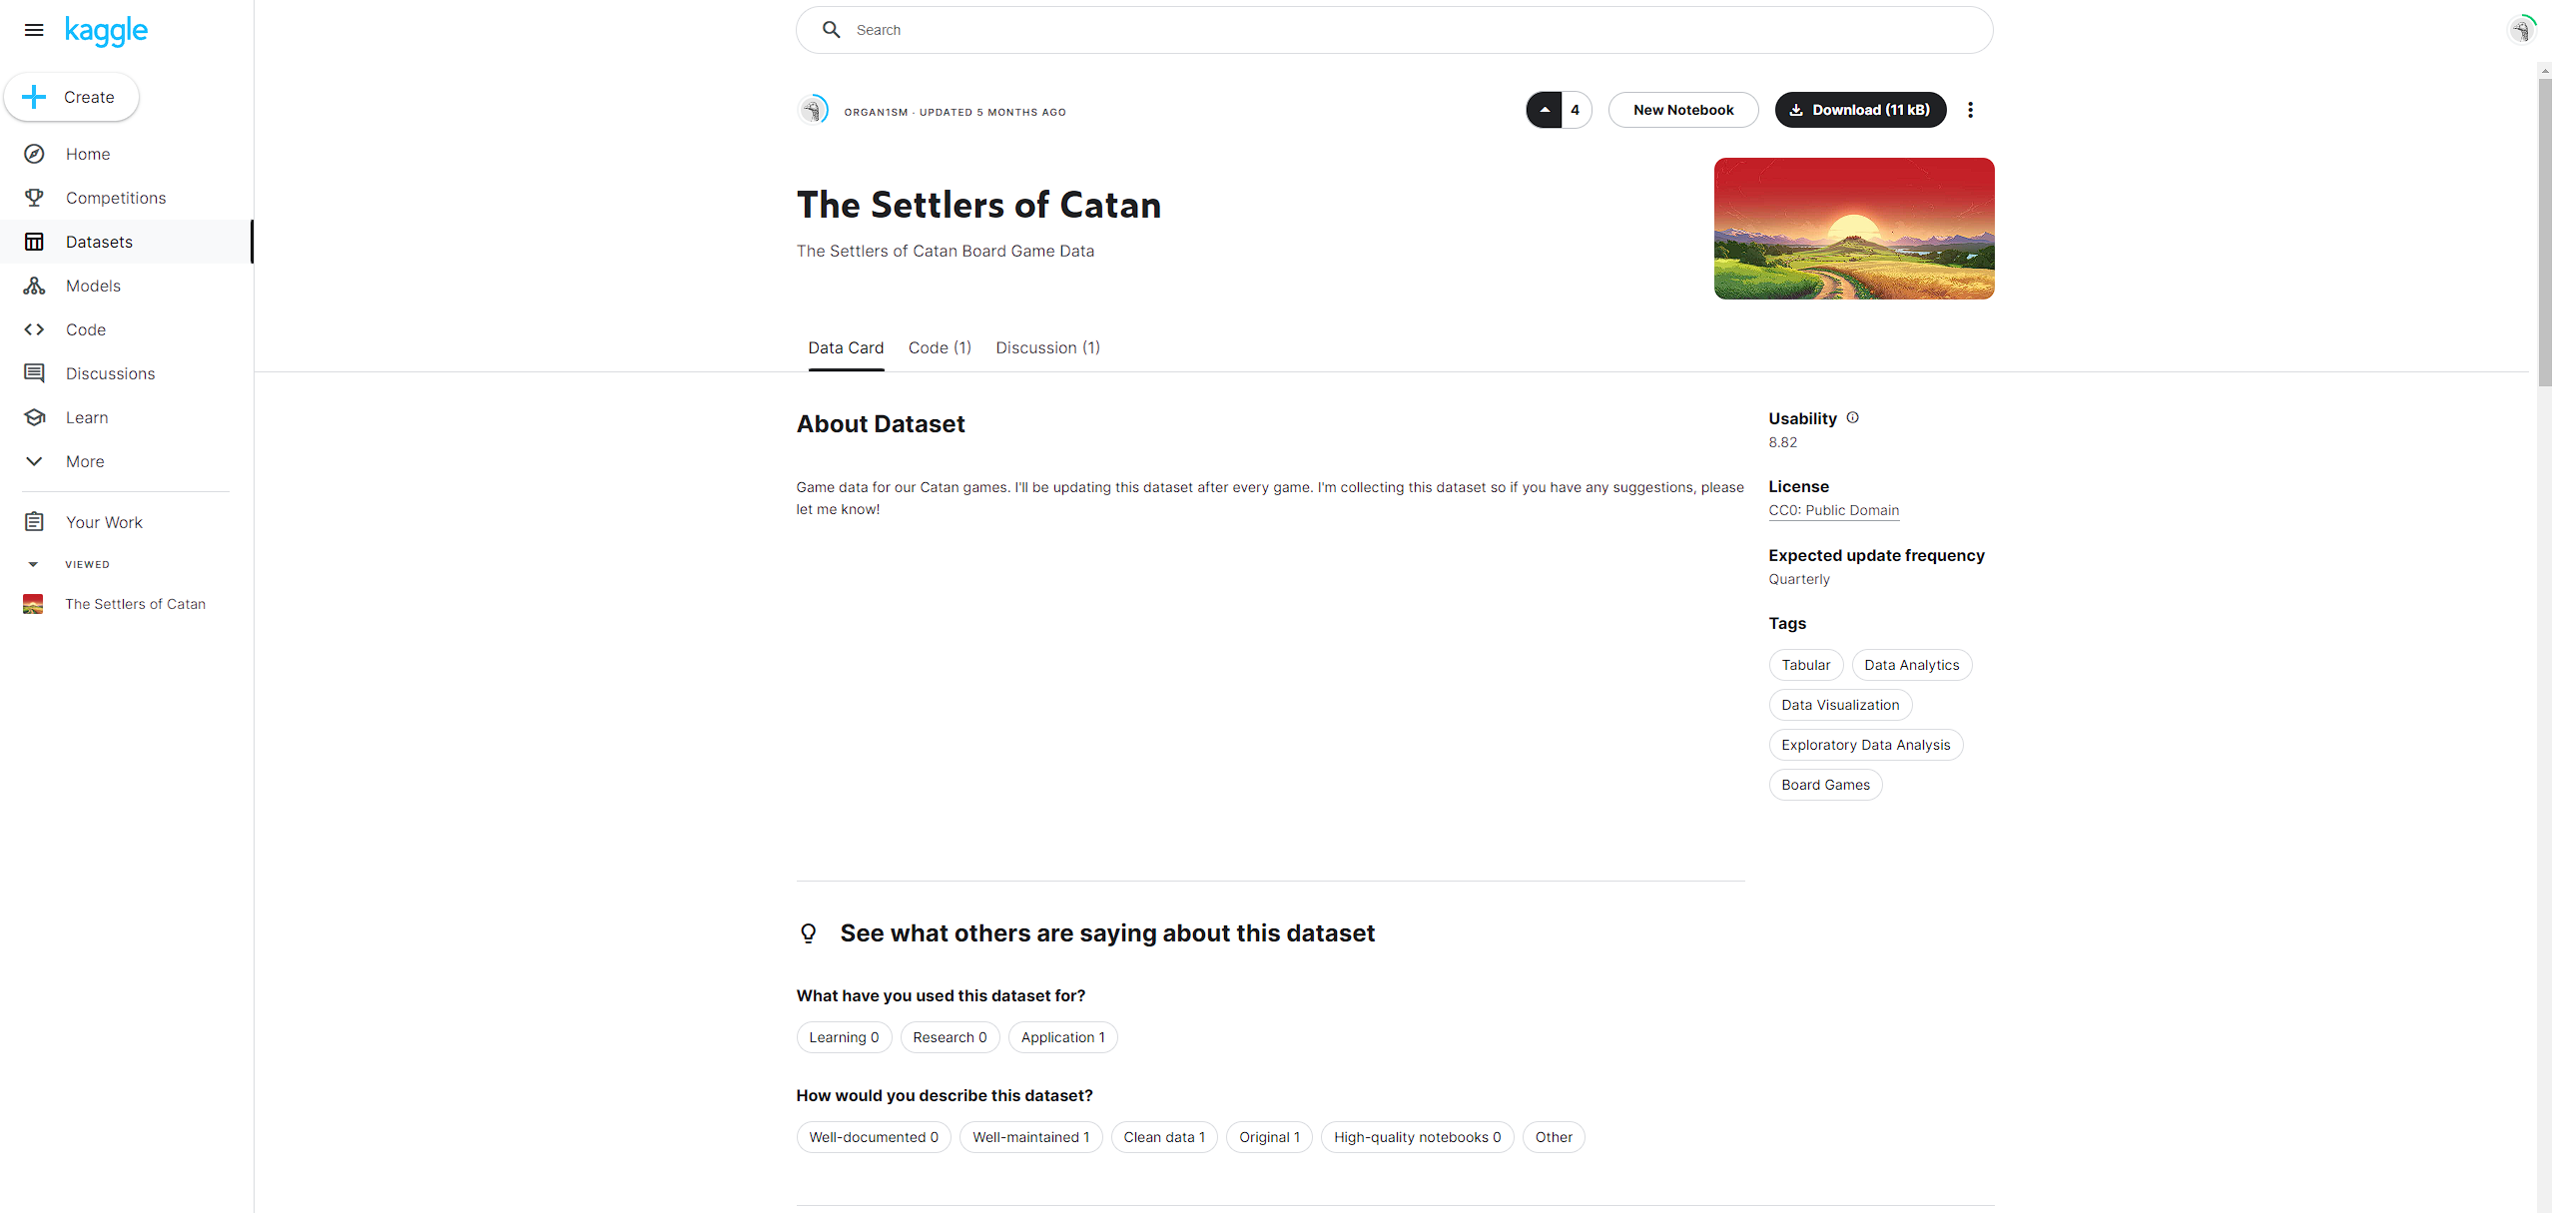
Data retrieval

Slide 8
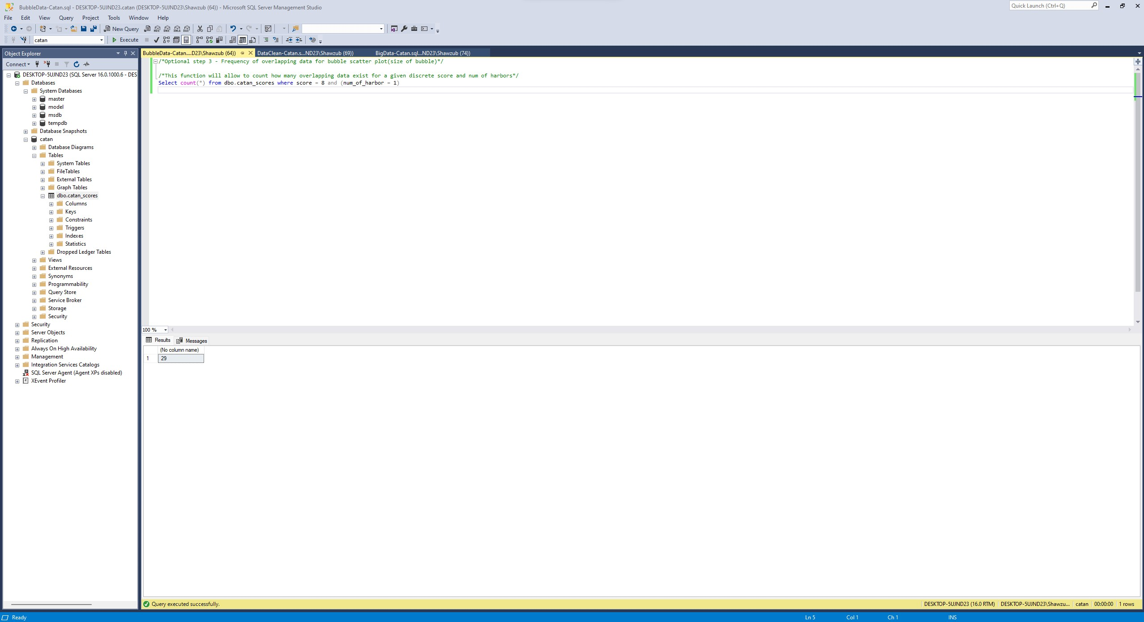
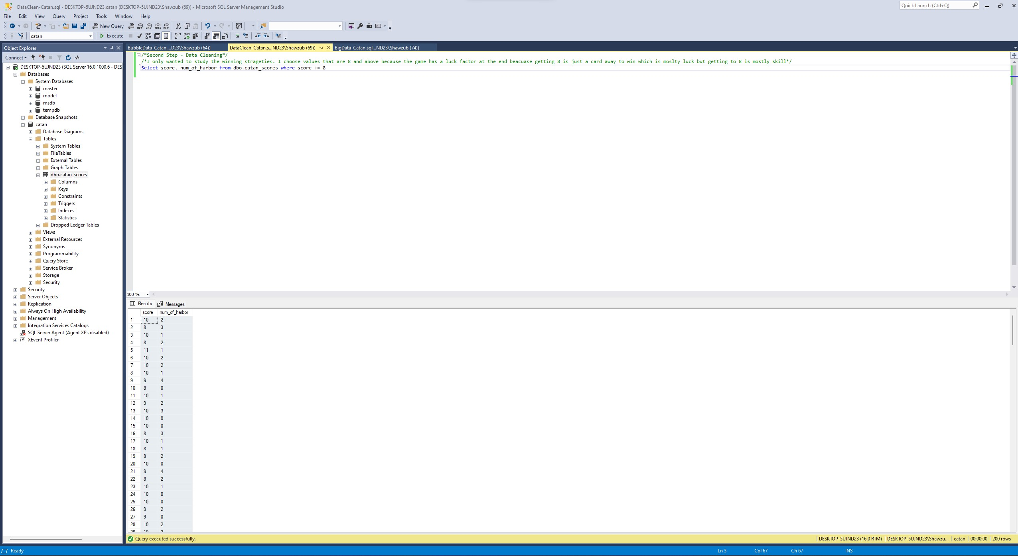
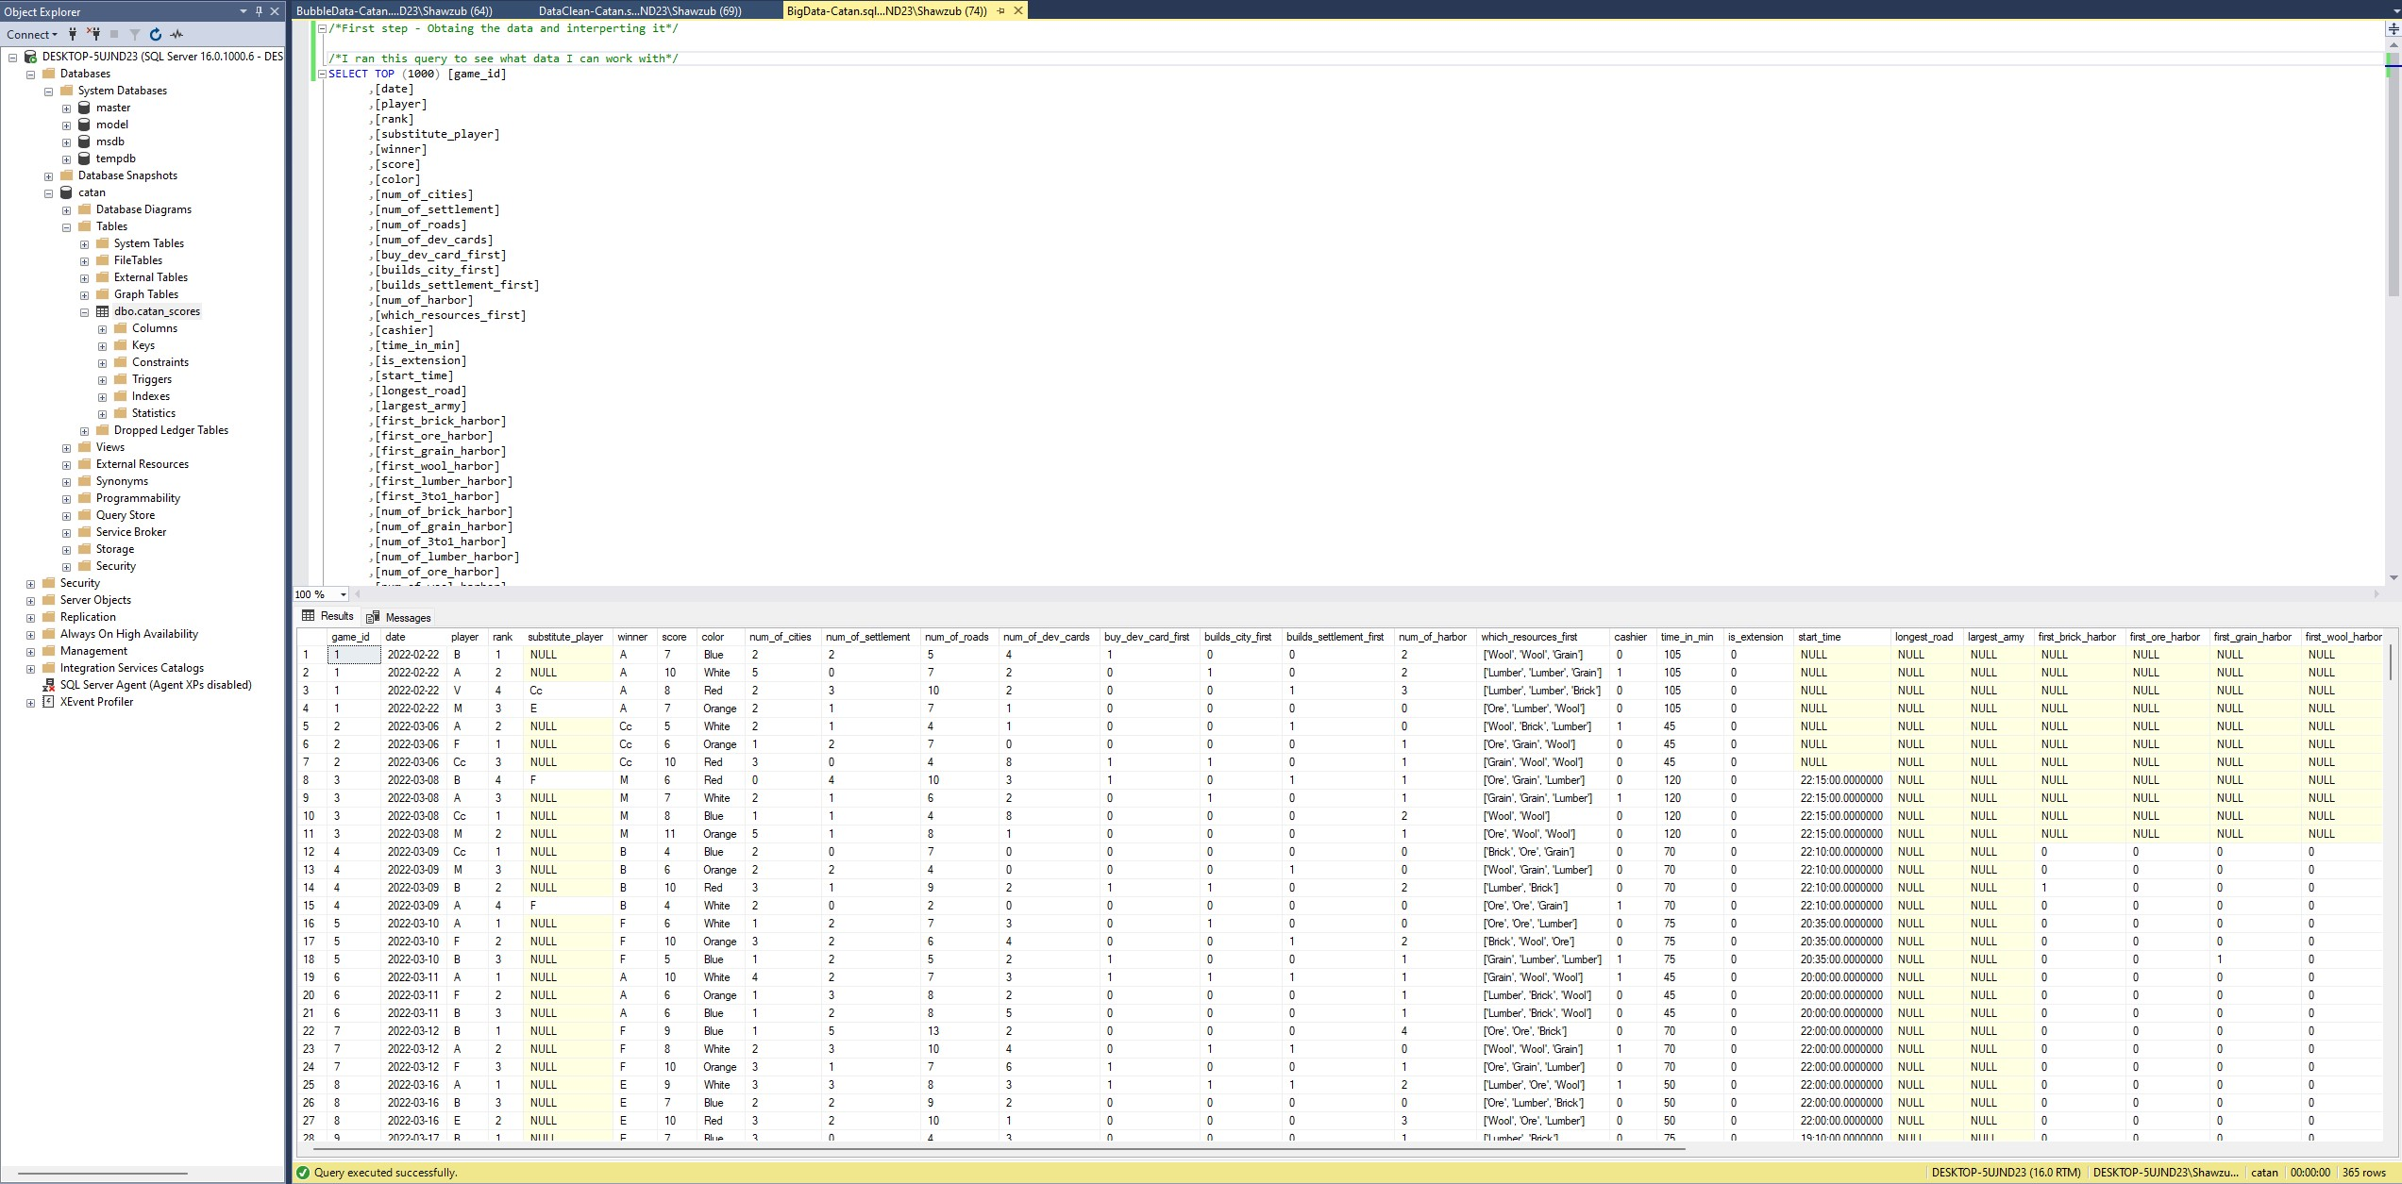
Data Querying/Cleaning

Slide 9
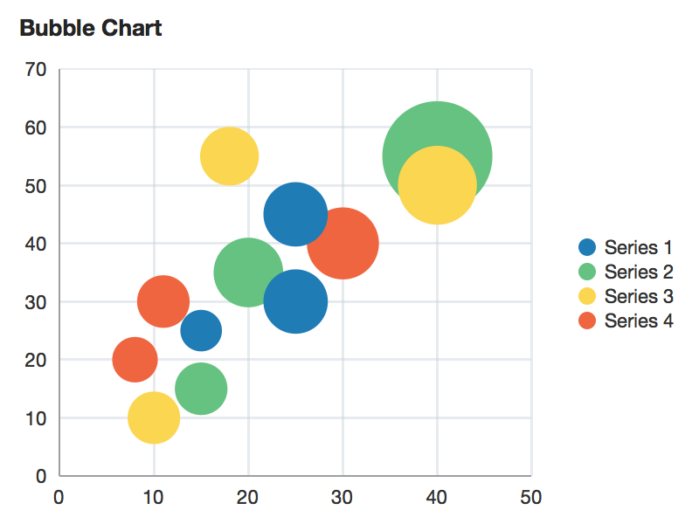
What is a K-mean and Why use it

Slide 10
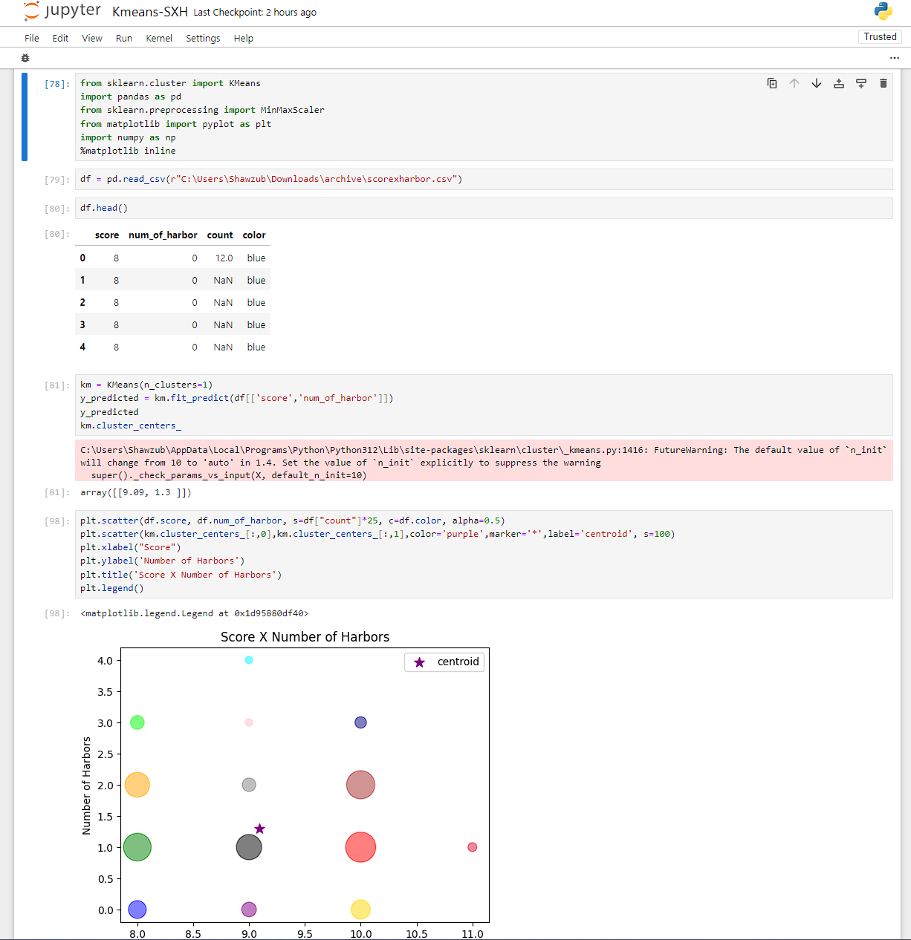
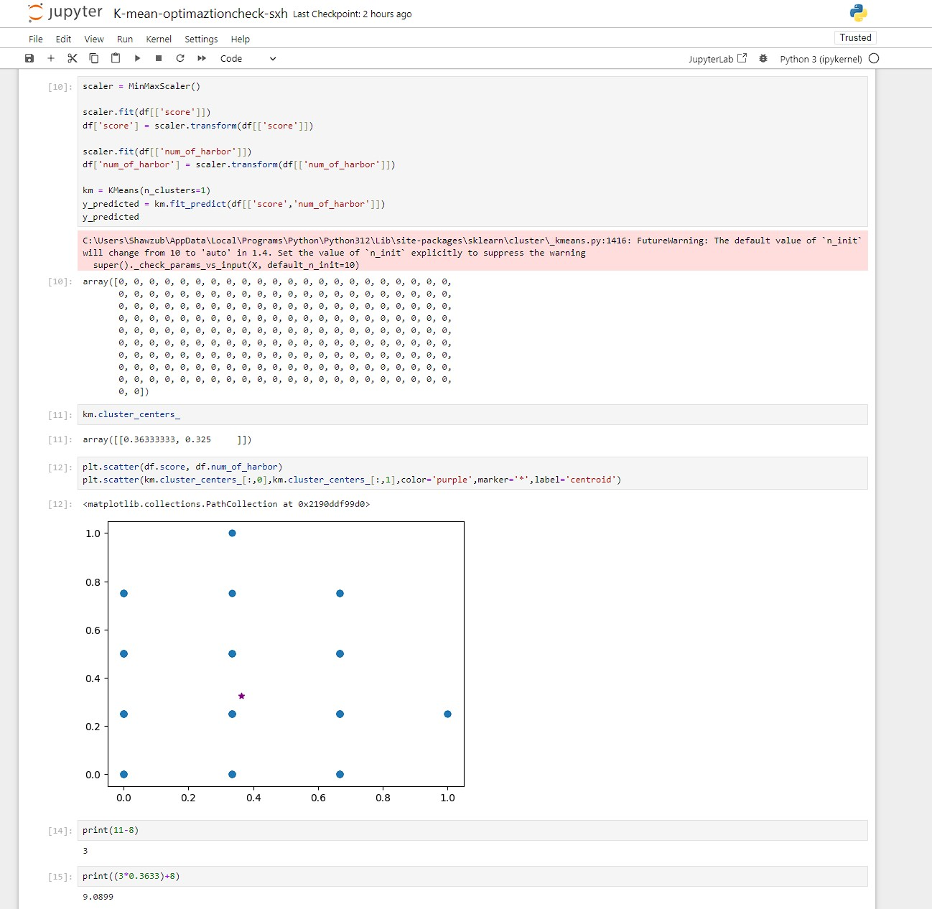
Data Analysis

Slide 11
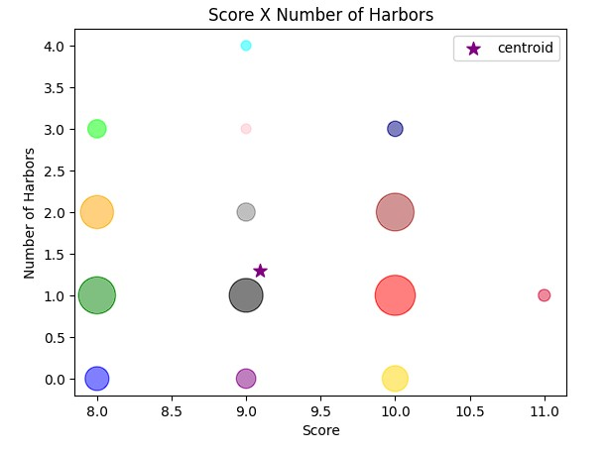
Final Result
Centroid: (9.09 score, 1.3 harbor)

Slide 12
Psychological explanation: Social Exchange Theory
People will only have reciprocated altruism in hopes they get something out of it. When you get to “end game”, trading will diminish due to playing to win for themselves while reducing chances for other players to win. So, its important to have a harbor(s) to support the “end game” trading fall off.

Slide 13
How is this different from what is currently out there?
I have not a seen a source where they have rigorously analysis harbor advantage to winning

Slide 14
Limitations
Is it any harbor or is it a specific type
Is it a random occurrence to have a harbor just by limited settlement placements

Slide 15
Thank You!

